Slide 1

18.404/6.840 Lecture 21
Last time: - Log-space reducibility
- L = NL? question
- $PATH$ is NL-complete
- $\overline{2SAT}$ is NL-complete
- NL = coNL (unfinished)
Today: (Sipser §9.1) - Finish NL = coNL
- Time and Space Hierarchy Theorems
1

Slide 2







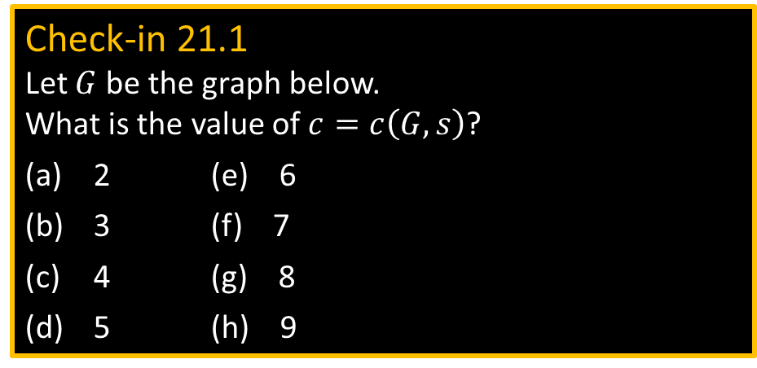


NL = coNL (part 1/4)
Theorem (Immerman-Szelepcsényi): NL = coNL
Proof: Show $\overline{PATH}∈$ NL
Defn: NTM $M$ computes function $f:Σ^{∗}→Σ^{∗}$ if for all $w$
All branches of $M$ on $w$ halt with $f\left(w\right)$ on the tape or reject.
Some branch of $M$ on $w$ does not reject.
Let $path\left(G,s,t\right)=\left\{\begin{aligned} \\ \end{aligned}\right.$
Let $R=R\left(G,s\right)=\left\{u\right| path\left(G,s,u\right)=$ YES}
Let $c=c\left(G,s\right)=|R|$
$R$ = Reachable nodes
$c$ = # reachable
Theorem: If some NL-machine (log-space NTM) computes $path$, then some NL-machine computes $c$.
Proof: “On input $〈G,s〉$
1. Let $k←0$
2. For each node $u$
3. If $path\left(G,s,u\right)=$ YES, then $k←k+1$
4. If $path\left(G,s,u\right)=$ NO, then continue
5. Output $k$”
Next: Converse of above
Check-in 21.1
Let $G$ be the graph below. What is the value of $c=c\left(G,s\right)$?
2 (e) 6
3 (f) 7
4 (g) 8
5 (h) 9
YES, if $G$has a path from $s$ to $t$
NO, if not
$$s$$
$$G=$$
$$G$$
$$R$$
$$s$$
$$c=|R|$$
2
Check-in 21.1

Slide 3





NL = coNL (part 2/4) – key idea
Theorem: If some NL-machine computes $c$, then some NL-machine computes $path$.
Proof: “On input $〈G,s,t〉$ where $G$ has $m$ nodes
1. Compute $c$
2. $k←0$
3. For each node $u$
4. Nondeterministically go to (p) or (n)
(p) Nondeterministically pick a path from $s$ to $u$ of length $≤m$.
If fail, then reject.
If $u=t$, then output YES, else set $k←k+1$.
(n) Skip $u$ and continue.
5. If $k≠c$ then reject.
6. Output NO.” [found all $c$ reachable nodes and none were $t$}
$$G$$
$$R$$
$$s$$
$$c=|R|$$
3

Slide 4

NL = coNL (part 2/4) – key idea SIMPLIFIED!!
Theorem: If some NL-machine computes $c$, then some NL-machine computes $path$.
Proof: “On input $〈G,s,t〉$ where $G$ has $m$ nodes
1. Compute $c$
2. $k←0$
3. For each node $u$
4. Nondeterministically pick a path from $s$ of length $≤m$.
If it ends at $t$ then output YES and stop. If it ends at $u$, set $k←k+1$.
5. If $k≠c$ then reject.
6. Output NO.” [found all $c$ reachable nodes and none were $t$}
$$G$$
$$R$$
$$s$$
$$c=|R|$$
4

Slide 5







NL = coNL (part 3/4)
Let $path_{d}\left(G,s,t\right)=\left\{\begin{aligned} \\ \end{aligned}\right.$
Let $R_{d}=R_{d}\left(G,s\right)=\left\{u\right| path_{d}\left(G,s,u\right)=$ YES}
Let $c_{d}=c_{d}\left(G,s\right)=|R_{d}|$
YES, if $G$has a path $s$ to $t$ of length $≤d$
NO, if not
Theorem: If some NL-machine computes $c_{d}$, then some NL-machine computes $path_{d}$.
Proof: “On input $〈G,s,t〉$
1. Compute $c_{d}$
2. $k←0$
3. For each node $u$
4. Nondeterministically go to (p) or (n)
(p) Nondeterministically pick a path from $s$ to $u$ of length $≤d$.
If fail, then reject.
If $u=t$, then output YES, else set $k←k+1$.
(n) Skip $u$ and continue.
5. If $k≠c_{d}$ then reject.
6. Output NO” [found all $c_{d}$ reachable nodes and none were $t$}
$$G$$
$$R_{d}$$
$$s$$
$$c_{d}=|R_{d}|$$
5

Slide 6






NL = coNL (part 4/4)
Theorem: If some NL-machine computes $c_{d}$, then some NL-machine computes $path_{d+1}$.
Proof: “On input $〈G,s,t〉$
1. Compute $c$
2. $k←0$
3. For each node $u$
4. Nondeterministically go to (p) or (n)
(p) Nondeterministically pick a path from $s$ to $u$ of length $≤d$.
If fail, then reject.
If $u$ has an edge to $t$, then output YES, else set $k←k+1$.
(n) Skip $u$ and continue.
5. If $k≠c_{d}$ then reject.
6. Output NO.” [found all $c_{d}$ reachable nodes
and none had an edge to $t$}
$$G$$
$$R_{d}$$
$$R_{d+1}$$
$$s$$
$$c_{d}=|R_{d}|$$
$$c_{d+1}=|R_{d+1}|$$
Hence $\overline{PATH}∈$ NL
“On input $〈G,s,t〉$
1. $c_{0}=1$.
2. Compute each $c_{d+1}$ from $c_{d}$ for $d=1$ to $m$.
3. Accept if $path_{m}(G,s,t)$ = NO.
4. Reject if $path_{m}(G,s,t)$ = YES.”
Corollary: Some NL-machine computes $c_{d+1}$ from $c_{d}$.
6

Slide 7



Review: Major Complexity Classes
L $⊆$ NL $⊆$ P $⊆$ NP $⊆$ PSPACE
$$≠$$
Today
The time and space hierarchy theorems show that if a TM is given more time (or space) then it can do more.*
* certain restrictions apply.
For example:
TIME$\left(n^{2}\right) ⊆ \text{,}$ TIME$\left(n^{3}\right)$ [ $⊆ \text{,}$means proper subset ]
SPACE$\left(n^{2}\right) ⊆ \text{,}$ SPACE$\left(n^{3}\right)$
7

Slide 8





Space Hierarchy Theorem (1/2)
Theorem: For any $f:ℕ→ℕ$ (where $f$ satisfies a technical condition) there is a language $A$ where $A$ requires $O\left(f\left(n\right)\right)$ space, i.e,
1) $A$ is decidable in $O\left(f\left(n\right)\right)$ space, and
2) $A$ is not decidable in $o\left(f\left(n\right)\right)$ space
On other words, SPACE$\left(o\left(f\left(n\right)\right)\right) ⊆ \text{,}$ SPACE$\left(f\left(n\right)\right)$
Notation: SPACE$\left(o\left(f\left(n\right)\right)\right)=\{B|$some TM $M$ decides $B$ in space $o\left(f\left(n\right)\right)\}$
Proof outline: (Diagonalization) Give TM $D$ where
1) $D$ runs in $O\left(f\left(n\right)\right)$ space
2) $D$ ensures that $L(D)≠L(M)$ for every TM $M$ that runs in $o\left(f\left(n\right)\right)$ space.
Let $A=L(D)$.
$$A$$
SPACE$\left(f\left(n\right)\right)$
SPACE$\left(o\left(f\left(n\right)\right)\right)$
8

Slide 9



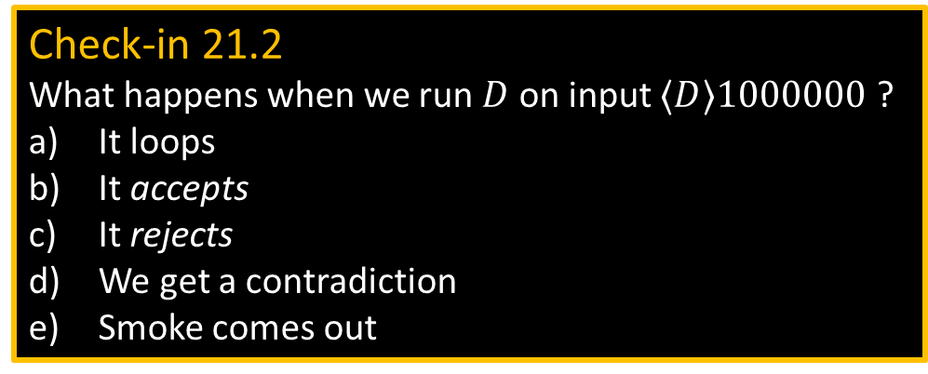






Space Hierarchy Theorem (2/2)
$$f\left(n\right)$$
Mark off $f\left(n\right)$ tape
$$n$$
$$⋯ w ⋯$$
Hide me →
$$D$$
$$w=010110⋯10100000$$
#
Goal: Exhibit $A∈$ SPACE$\left(f\left(n\right)\right)$ but $A∉$ SPACE$\left(o\left(f\left(n\right)\right)\right)$
Give $D$ where $A=L(D)$ and
1) $D$ runs in $O\left(f\left(n\right)\right)$ space
2) $D$ ensures that $L(D)≠L(M)$ for every TM $M$ that runs in $o\left(f\left(n\right)\right)$ space.
$D=$ “On input $w$
1. Mark off $f(n)$ tape cells where $n=|w|$.
If ever try to use more tape, reject.
2. If $w≠〈M〉{10}^{∗}$ for some TM $M$, reject.
3. Simulate* $M$ on $w$ for $2^{f\left(n\right)}$ steps
Accept if $M$ rejects,
Reject if $M$accepts or hasn’t halted.”
*Note: $D$ can simulate $M$ with a constant factor space overhead.
$$〈M〉$$
Issues:
What if $M$ runs in $o\left(f\left(n\right)\right)$ space but has a big constant? Then $D$ won’t have space to simulate $M$ when $w$ is small.
FIX: simulate $M$ on infinitely many $w$.
2. What if $M$ loops? [$D$ must always halt]
FIX: Stop $M$ if it runs for $2^{f\left(n\right)}$ steps.
3. How to compute $f$?
FIX: Assume $f$ is space constructible, i.e., can compute $f$ within $O(f\left(n\right))$ space.
Nice functions like $\log{n}$, $\log^{2}{n}$, $n$, $n^{2}$, $2^{n}$, … are all space constructible.
Check-in 21.2
What happens when we run $D$ on input $〈D〉1000000$ ?
It loops
It accepts
It rejects
We get a contradiction
Smoke comes out
9
Check-in 21.2

Slide 10


Time Hierarchy Theorem (1/2)
Theorem: For any $f:ℕ→ℕ$ where $f$ is time constructible there is a language $A$ where $A$ requires $O\left(f\left(n\right)\right)$ time, i.e,
1) $A$ is decidable in $O\left(f\left(n\right)\right)$ time, and
2) $A$ is not decidable in $o\left(f\left(n\right)/\log\left(f\left(n\right)\right)\right)$ time
On other words, TIME$\left(o\left(\frac{f\left(n\right)}{\log\left(f\left(n\right)\right)}\right)\right) ⊆ \text{,}$ TIME$\left(f\left(n\right)\right)$
Proof outline: Give TM $D$ where
1) $D$ runs in $O\left(f\left(n\right)\right)$ time
2) $D$ ensures that $L(D)≠L(M)$ for every TM $M$ that runs in $o\left(f\left(n\right)/\log\left(f\left(n\right)\right)\right)$ time .
Let $A=L(D)$.
10

Slide 11


Time Hierarchy Theorem (2/2)
Goal: Exhibit $A∈$ TIME$\left(f\left(n\right)\right)$ but $A∉$ TIME$\left(o\left(f\left(n\right)/\log\left(f\left(n\right)\right)\right)\right)$
$A=L(D)$ where
1) $D$ runs in $O\left(f\left(n\right)\right)$ time
2) $D$ ensures that $L(D)≠L(M)$ for every TM $M$ that runs in $o\left(f\left(n\right)/\log\left(f\left(n\right)\right)\right)$ time.
$D=$ “On input $w$
1. Compute $f(n)$.
2. If $w≠〈M〉{10}^{∗}$ for some TM $M$, reject.
3. Simulate* $M$ on $w$ for $f\left(n\right)/\log\left(f\left(n\right)\right)$ steps.
Accept if $M$ rejects,
Reject if $M$accepts or hasn’t halted.”
*Note: $D$ can simulate $M$ with a log factor time overhead due to the step counter.
Why do we lose a factor of $\log\left(f\left(n\right)\right)$?
$D$ must halt within $O\left(f\left(n\right)\right)$ time.
To do so, $D$ counts the number of steps it uses and stops if the limit is exceeded. The counter has size $\log\left(f\left(n\right)\right)$ and is stored on the tape.
It must be kept near the current head location.
Cost of moving it adds a $O\left(\log\left(f\left(n\right)\right)\right)$ overhead factor. So to halt within $O\left(f\left(n\right)\right)$ time, $D$ stops when the counter reaches $f\left(n\right)/\log\left(f\left(n\right)\right)$.
11

Slide 12

Recap: Separating Complexity Classes
L $⊆$ NL $⊆$ P $⊆$ NP $⊆$ PSPACE
$$≠$$
Space Hierarchy Theorem
NL $⊆$ SPACE$\left(\log^{2} n\right) ⊆ \text{,}$ SPACE$\left(n\right)$ $⊆$ PSPACE
Check-in 21.3
Consider these two famous unsolved questions:
Does L = P?
Does P = PSPACE?
What do the hierarchy theorems tell us about these questions?
Nothing
At least one of these has answer “NO”
At least one of these has answer “YES”
12
Check-in 21.3

Slide 13
Quick review of today
Finish NL = coNL
Space hierarchy theorem
Time hierarchy theorem
13

Slide 14
MIT OpenCourseWare
https://ocw.mit.edu
18.404J Theory of Computation
Fall 2020
For information about citing these materials or our Terms of Use, visit: https://ocw.mit.edu/terms.

